Slide 1

Electromagnetic Modelling of the Wireless Communication Channels Assisted with
Reconfigurable Intelligent Surfaces (RIS)
Serden Sait ERANİL - 040170025
Ramazan Umut AKTAŞ - 040190762
21.06.2022

Slide 2

Content
Why the RIS is promising technology ?
RIS Assisted Wireless Channel Properties
Scope of the Senior Design Project
Overall Channel Model
Equations of the Channels
RIS Structure
Response of the RIS
Optimizing the RIS Response
Simulation Results: SNR vs. Achievable Rate (N = 256)
Simulation Results: SNR vs. Achievable Rate (N = 1024)
Simulation Results: RIS Size vs. Achievable Rate
Simulation Results: XRIS vs. Achievable Rate (1st case)
Simulation Results: XRIS vs. Achievable Rate (2nd case)
Conclusion

Slide 3
Why the RIS is promising technology ?
RIS is a nearly passive device that consumes low power.
RIS utilization provides features that can be exploited for increasing communication performance
RIS has the capability of applying wave transformations that can not be applied by the materials found in nature
Reconfigurability of the RIS makes it adaptive

Slide 4
RIS Assisted Wireless Channel Properties
RIS utilization provides a partial control over propagating EM waves and channel.
Control over phase
Control over amplitude
Control over polarization
Control over propagation direction
As a result, RIS assisted channel provides novel features and advantages such as:
New modulation schemes: Binary Polarization Shift Keying etc.
Increase in SNR and achievable rate
Blocking eavesdropping
Beamforming with low power consumption

Slide 5
Scope of the Senior Design Project
To exploit advantages of the RIS utilization, RIS assisted channel should be modeled.
Thus, limits of the RIS utilization, optimum design and implementation cases can be determined.
This project aims to provide physical end to end channel model for RIS assisted channels
RIS assisted channel modeling consists of two parts:
Modeling the electromagnetic response of the RIS
Modeling the stochastic channel parameters such as: path loss, phase shift, angles, polarizations etc.

Slide 6
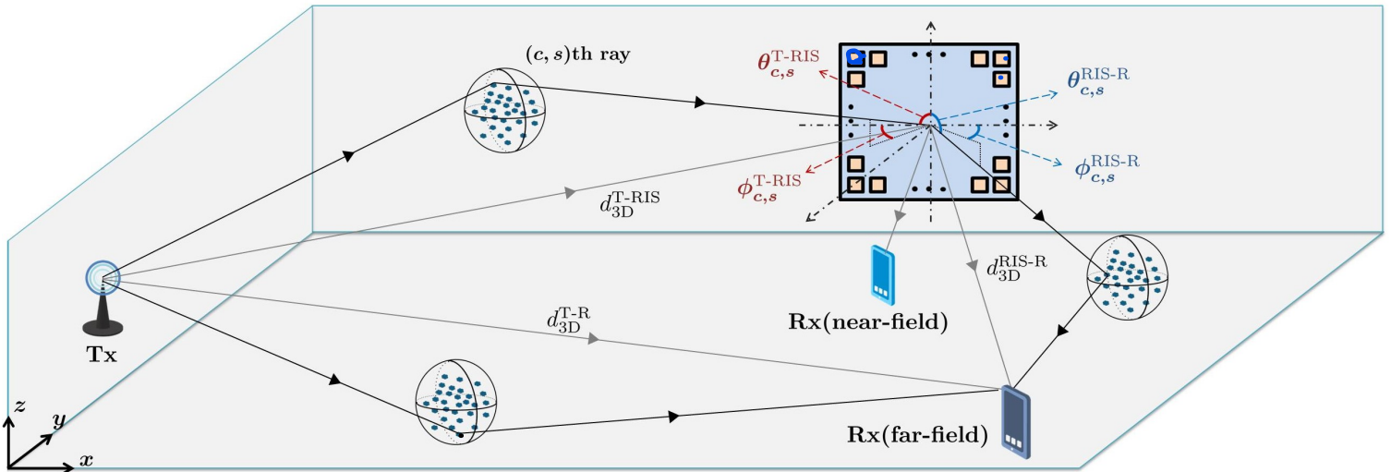
Overall Channel Model

Slide 7
Overall Channel Model
Random variables for channel parameters should be introduced:
Path loss including shadowing
Distance dependent LOS probabilities
Polarization dependent attenuation and phase shifts
Azimuth and zenith angles of arrival
Number of clusters and scatterers
Cluster powers
Deterministic parameters are:
Wavelength
Antenna radiation patterns
Array response vector of the RIS
RIS response matrix

Slide 8
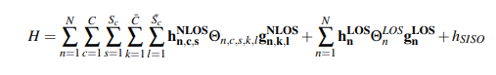
Overall Channel Model
Multiple channels: Tx – RIS, RIS – Rx, Tx – Rx
Operating frequencies from 0.5 to 100 GHz
Clusters and scatterers are responsible of some of the disruptive effects
Path loss, shadowing, multipath fading
Received signal (y) can be expressed in terms of transmitted signal (x) as:
y = Hx + n, where n is AWGN
Direct channel between transmitter and receiver and RIS to transceiver channels
Coefficient for each ray scattered towards receiver

Slide 9
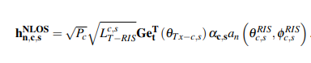
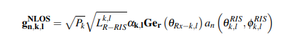
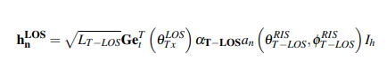
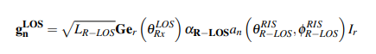
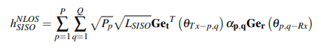
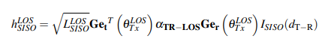
Equations of the Channels

Slide 10
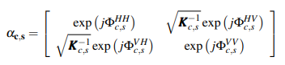
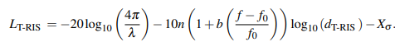
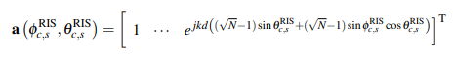
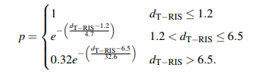
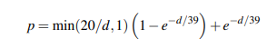
Equations of the Channels
LOS probabilities are dependent on the channel
Generation of random variables are environment dependent
LOS channels can be dominant if LOS probabilities are higher then 50%

Slide 11
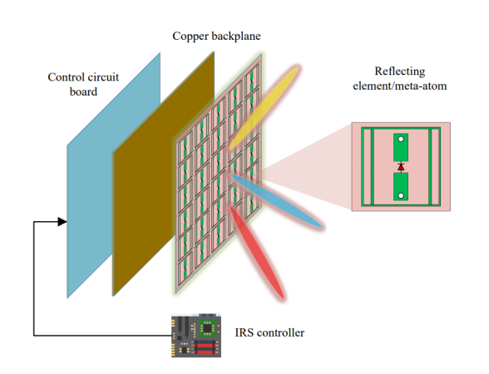
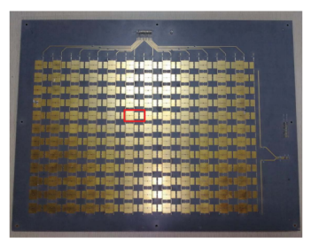
RIS Structure

Slide 12
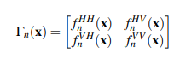
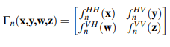
Response of the RIS
Surface Electromagnetics (SEM) based models and transmission line models are the most common approaches for RIS response modelling
RIS response is also based on the design of the RIS structure
Response is dependent on arrival angle, operating frequency and polarization.
Response of the nth RIS cell is given as above
Modeling approach and design technology determines the expression of matrix coefficients.

Slide 13
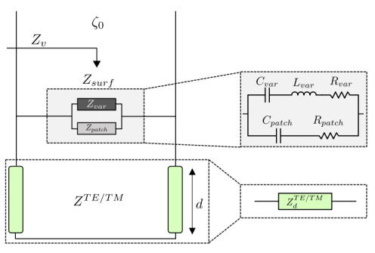
Response of the RIS
Transmission line model is used for modeling the RIS response
This approach is simpler and ignores more parameters compared to SEM based models.
Based on the assumption that constitutive parameters of the surface change only in the one direction in the meta-atom.

Slide 14
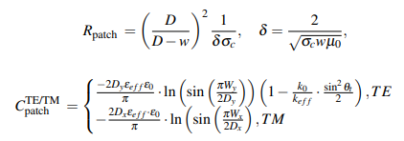
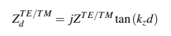
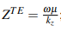
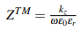
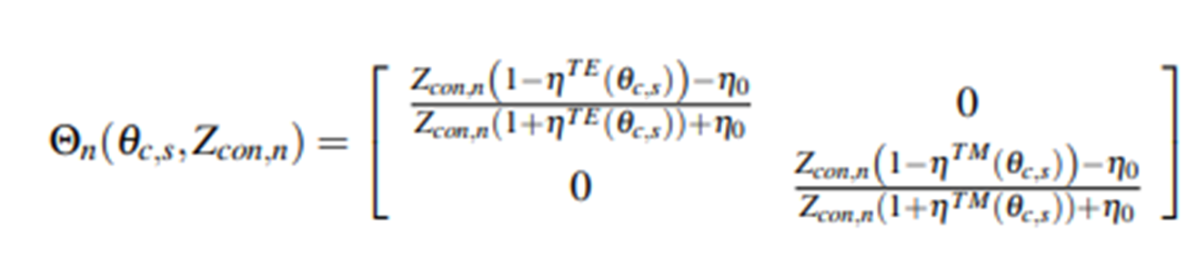
Response of the RIS
It is assumed that RIS response is controlled by a tunable impedance element
Cross polarized reflections are ignored
Intrinsic parameters are both dependent on material properties and geometry of the cell.

Slide 15
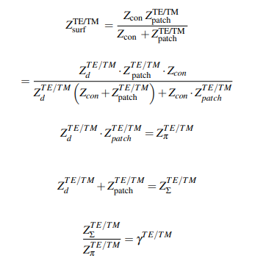
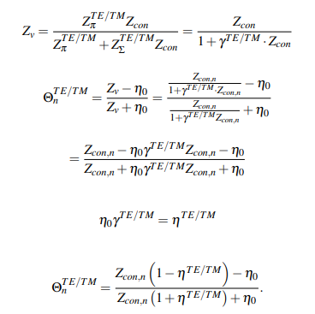
Response of the RIS

Slide 16
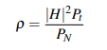
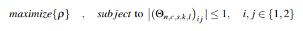
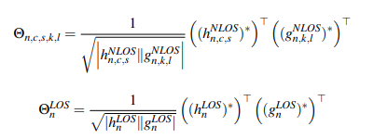
Optimizing the RIS Response
Objective function: Achievable rate
Design of the RIS, existence of SISO channel, channel information determines the formulation
Constraints stem from physical parameters used in RIS

Slide 17
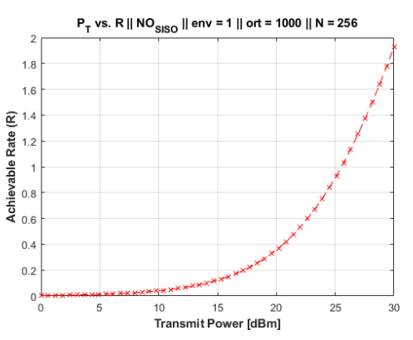
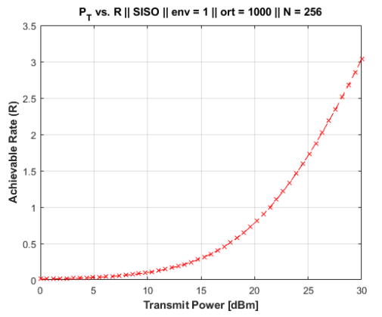
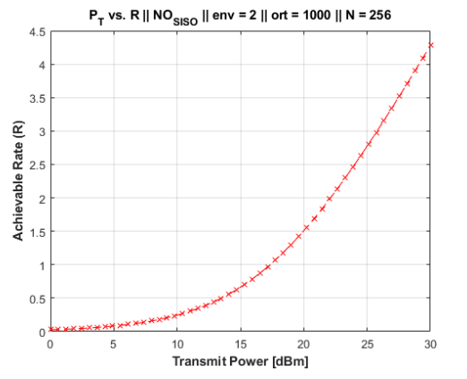
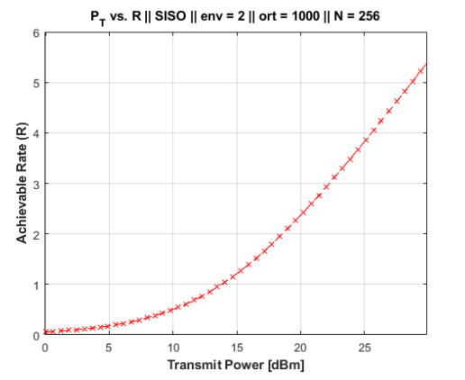
Simulation Results: SNR vs. Achievable Rate (N = 256)
For env = 1
g channel is LOS
SISO channel shares common clusters with h channel
For env = 2
g channel is LOS/NLOS
SISO channel experiences completely different clusters

Slide 18
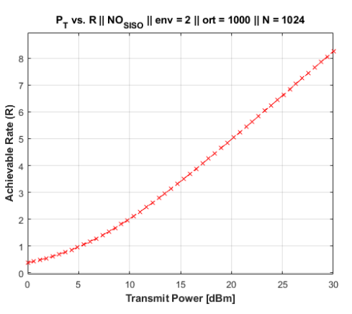
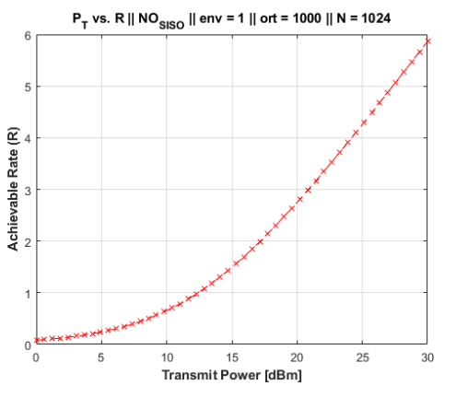
Simulation Results: SNR vs. Achievable Rate (N = 1024)
For env = 1
g channel is LOS
SISO channel shares common clusters with h channel
For env = 2
g channel is LOS/NLOS
SISO channel experiences completely different clusters

Slide 19
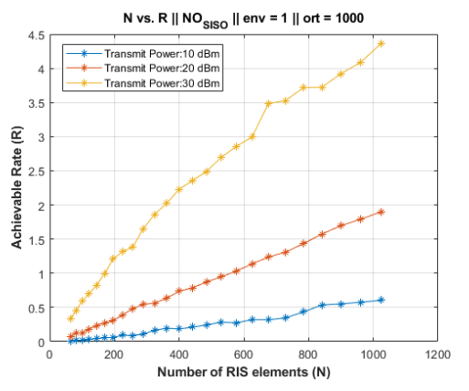
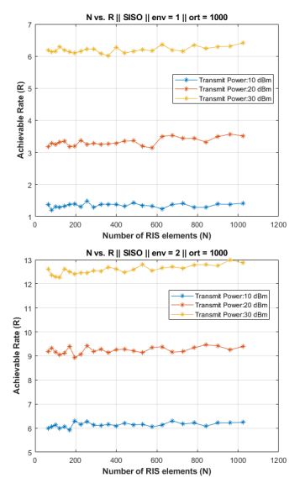
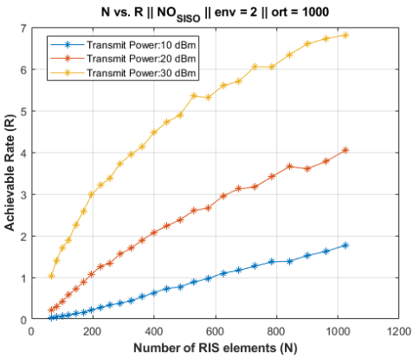
Simulation Results: RIS Size vs. Achievable Rate
For env = 1
g channel is LOS
SISO channel shares common clusters with h channel
For env = 2
g channel is LOS/NLOS
SISO channel experiences completely different clusters

Slide 20
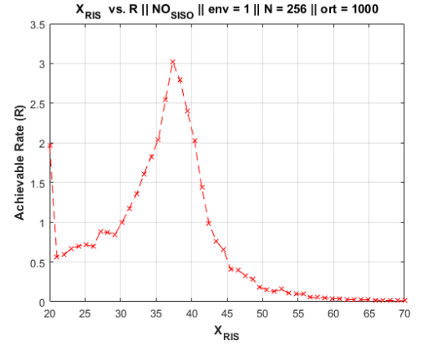
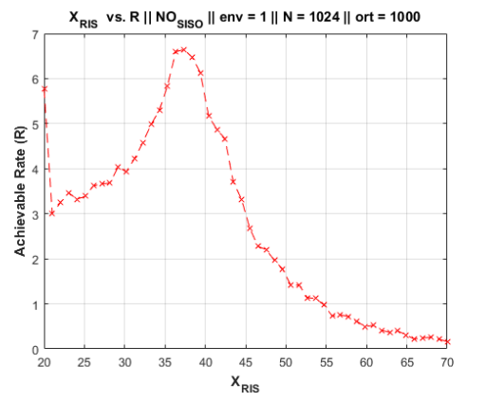
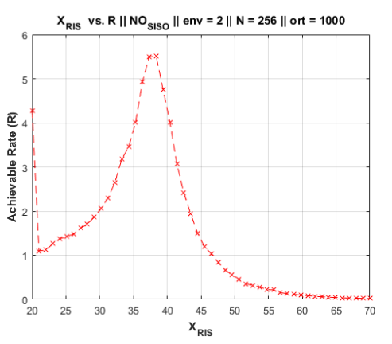
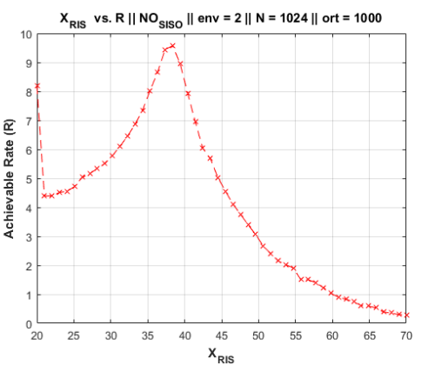
Simulation Results: X_{RIS} vs. Achievable Rate (1st case)
SISO CHANNEL
IS BLOCKED
Tx = (0,25,2)
RIS = (38,48,1)
Rx = (20,50,1)

Slide 21
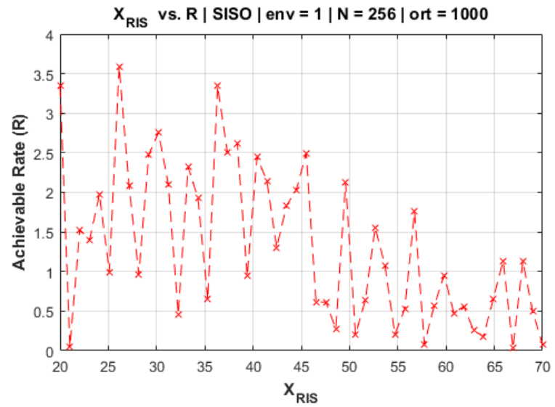
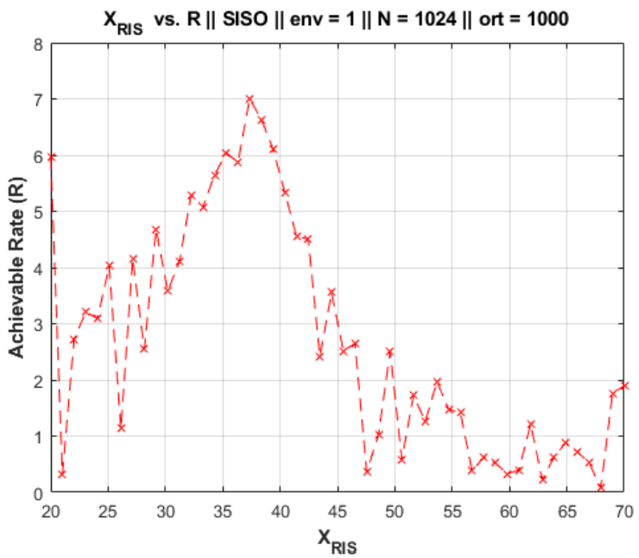
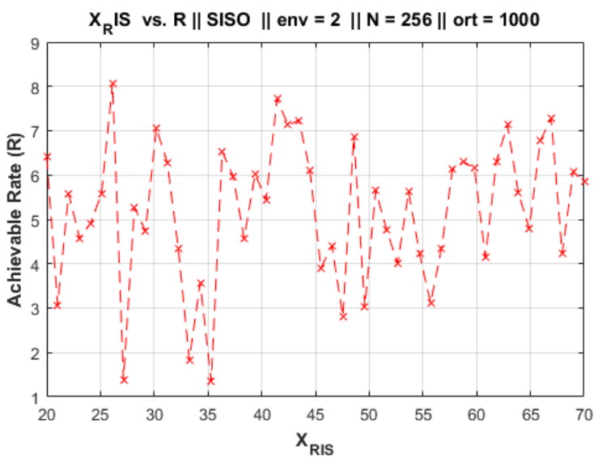
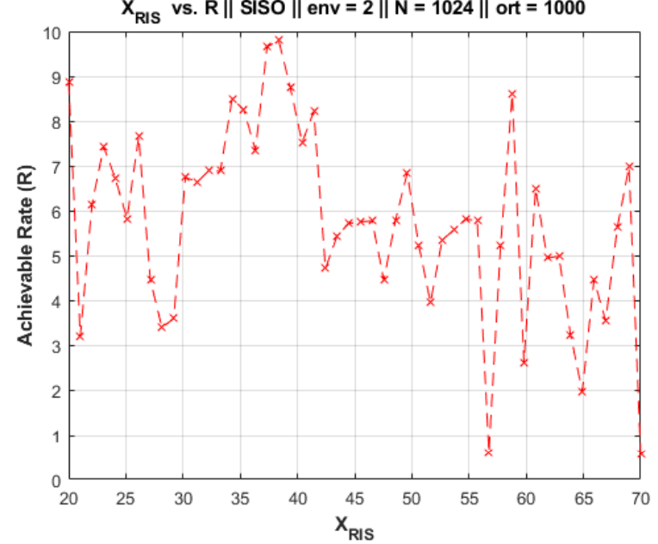
Simulation Results: X_{RIS} vs. Achievable Rate (1st case)
SISO CHANNEL
IS PRESENT
Tx = (0,25,2)
RIS = (38,48,1)
Rx = (20,50,1)

Slide 22
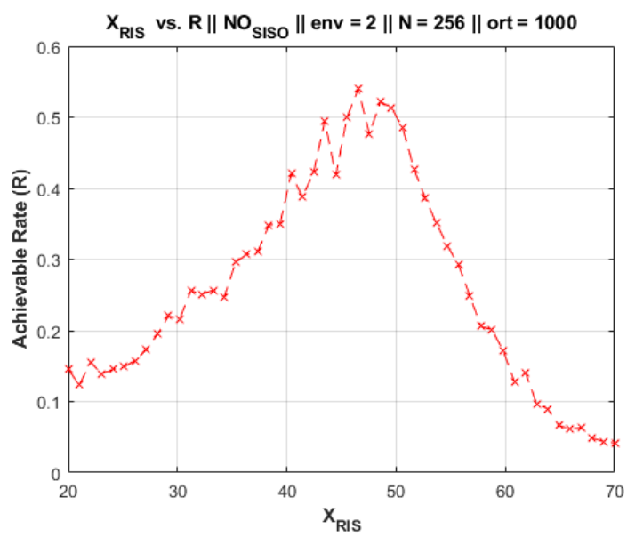
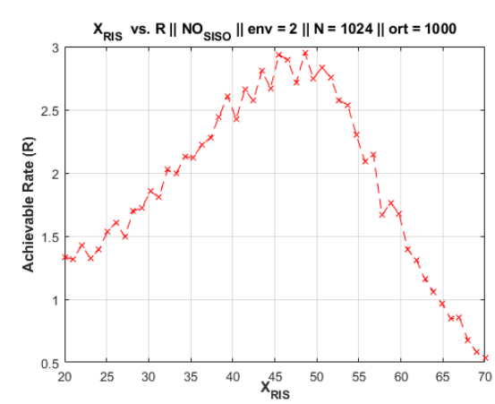
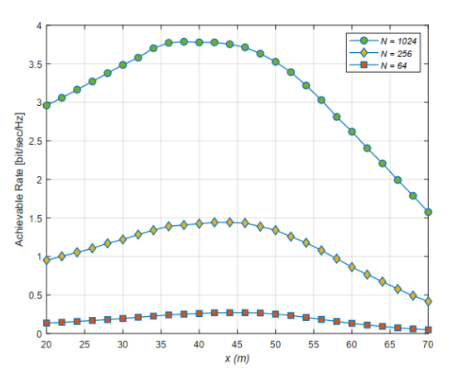
Simulation Results: X_{RIS} vs. Achievable Rate (2nd case)
SISO CHANNEL
IS BLOCKED
Tx = (0,25,20)
RIS = (20,60,10)
Rx = (50,50,1)

Slide 23
Conclusion
DEPLOYMENT OF RIS IN A CHANNEL WHERE DIRECT LINK CAN BE ESTABLISHED IS NOT FEASIBLE SINCE RIS CHANNEL SUFFERS FROM HIGH PATH LOSS.
OPTIMIZATION OF THE RIS RESPONSE IS A IMPORTANT ISSUE SINCE THE RESULTS ARE GIVEN FOR IDEAL RIS CONDITION, THE RESULTS IS GOING TO BE WORSE WHEN THE REALISTIC RESPONSE ARE CONSIDERED.
AN END-TO-END CHANNEL MODEL TAKING POLARIZATION AND ANTENNA RADIATION PATTERNS INTO CONSIDERATION IS PROPOSED.
THE PROPOSED MODEL PRODUCES SIMILAR RESULTS WITH THE REFERENCED RESEARCH AS SHOWN IN THE PREVIOUS SLIDE.
IN ORDER FOR RIS CHANNEL TO COMPETE WITH THE DIRECT CHANNEL, THE NUMBER OF RIS ELEMENTS SHOULD BE LARGE WHICH IS NOT FEASIBLE IN REAL-LIFE SCENARIOS BECAUSE OF THE DEPLOYING ISSUES.
AS A FUTURE WORK, OPTIMZATION OF THE RIS RESPONSE WILL BE ENHANCED AND IMPLEMENTED, MODULATION TYPE DEPENDENCY WILL BE INVESTIGATED, AND MEASUREMENTS CAN BE TAKEN FROM AN RIS.

Slide 24

THANK YOU FOR YOUR INTEREST AND YOUR TIME

